Slide 1
6 Principles of Game Based Learning
Sorting card activity
Slide 1 – Print and cut the activity
Slide 2 – Digital sorting activity

Slide 2
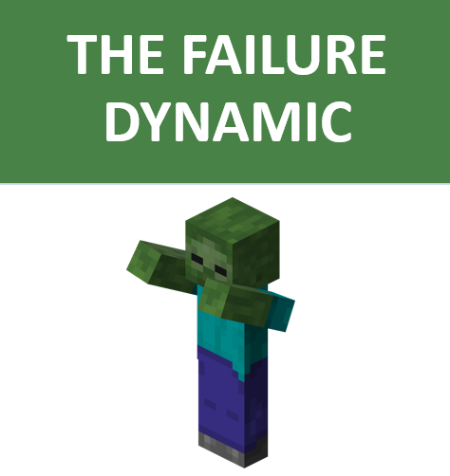


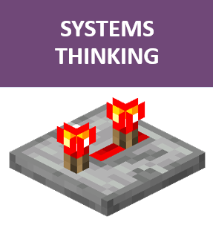
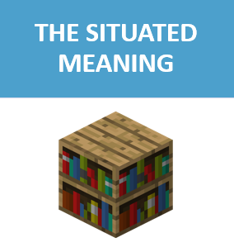

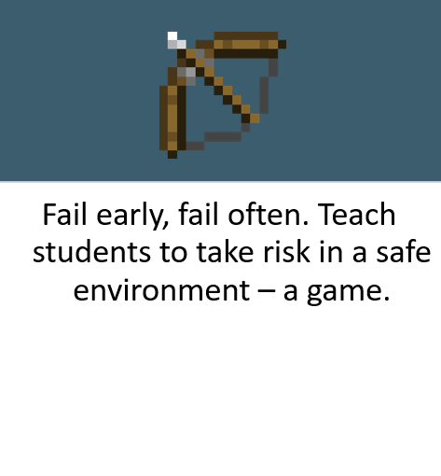
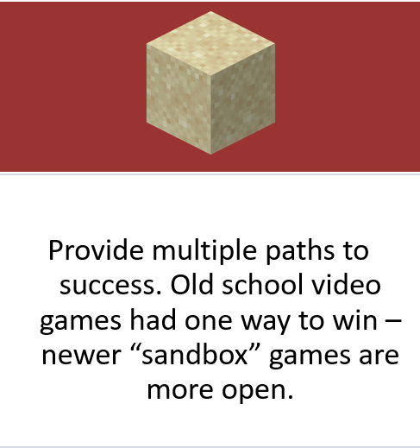
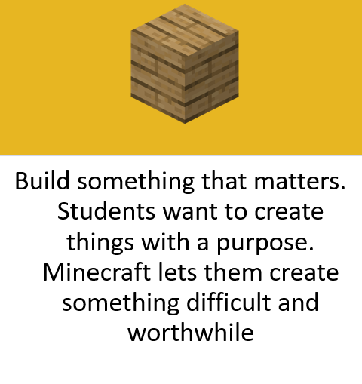
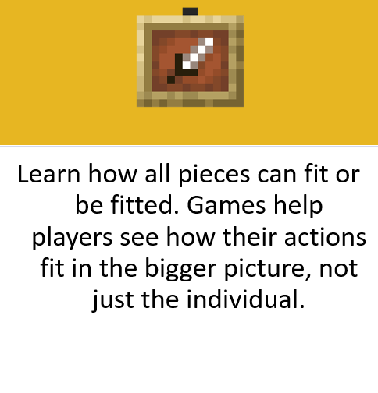
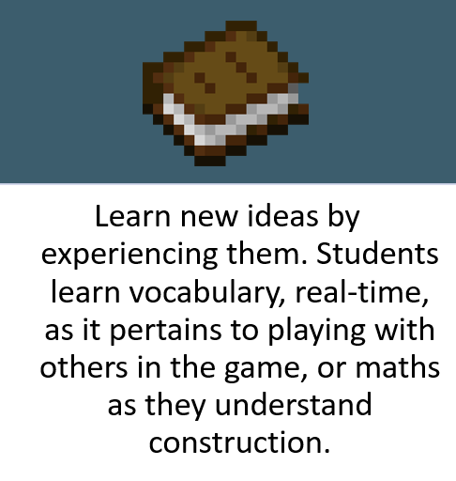
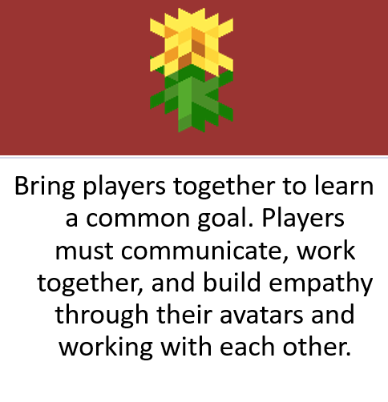
6 PRINCIPLES OF GAME BASED LEARNING - ANSWERS

Slide 3
6 PRINCIPLES OF GAME BASED LEARNING
Notes:
Game-based Learning.
Game-based learning is a teaching method that balances educational materials with the strategies, rules, and social aspects of playing a game.

