Slide 1
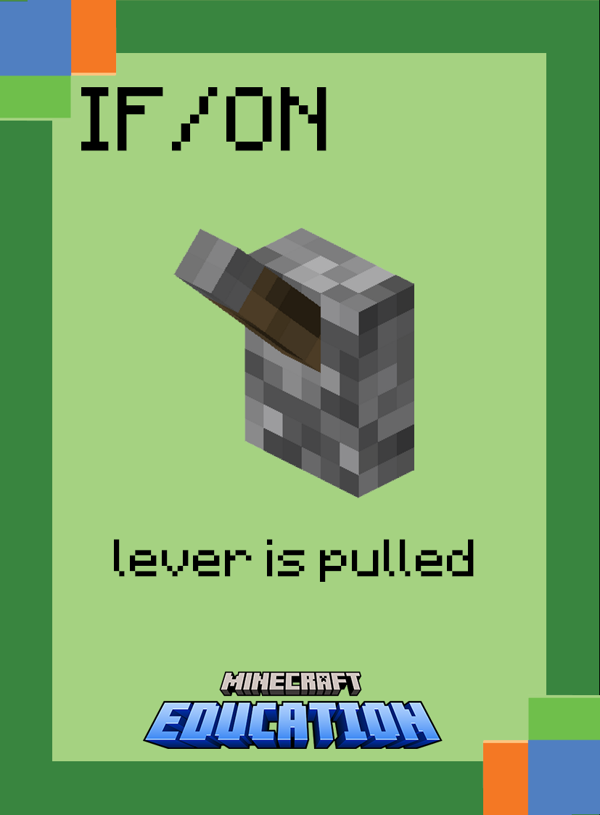
Intermediate Commands

Slide 2
Use your coding cards to show the following command in the correct order.
Fill Command
from is the starting x y z coordinate for the fill region (ie: first corner block)
to is the ending
x y z coordinate for the fill region (ie: opposite corner block)
titleName is the name of the block to fill the region
Notes:
Ask students to display which cards make up the following command. (the answer will be revealed card by card)
Break down the task by asking what each card does. (explanation will appear)
Challenge students to consider a gaming scenario that may use this command

Slide 3
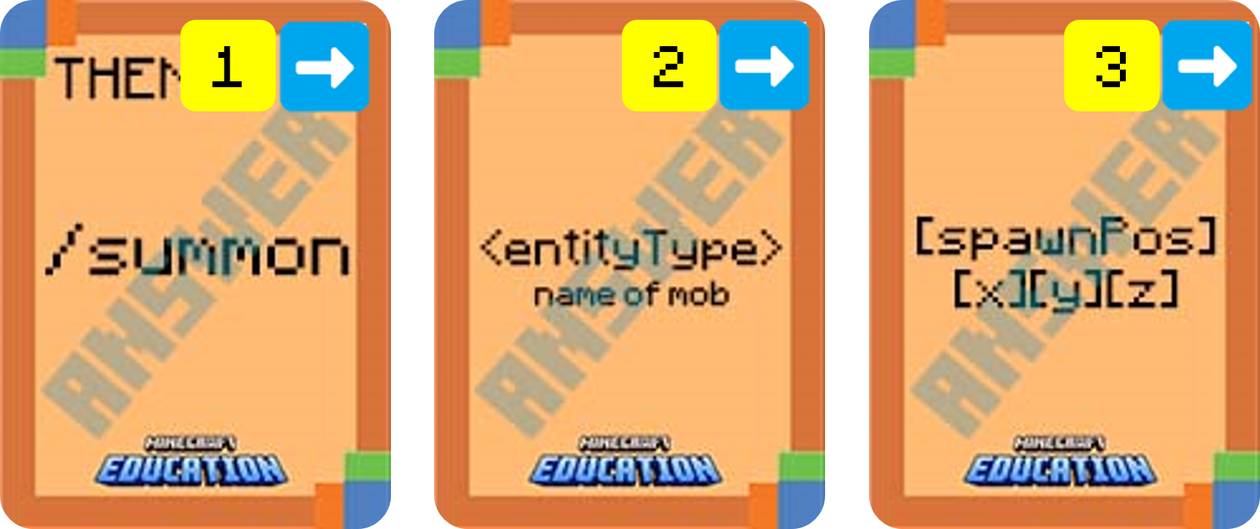
Use your coding cards to show the following command in the correct order.
Summon Command
entityType is the name of the entity to summon
spawnPos is optional. It is the
X y z coordinate where the entity should spawn. If you provide no coordinates, the entity will spawn in the player’s current location.
Notes:
Ask students to display which cards make up the following command. (the answer will be revealed card by card)
Break down the task by asking what each card does. (explanation will appear)
Challenge students to consider a gaming scenario that may use this command

Slide 4
Use your coding cards to show the following command in the correct order.
Title Command
player is the name of a player who you want to display a title screen for.
title : subtitle : actionbar type either title, subtitle or actionbar. You can only choose one. Title will provide a larger on screen text.
titleText is the message you want to appear on screen.
Notes:
Ask students to display which cards make up the following command. (the answer will be revealed card by card)
Break down the task by asking what each card does. (explanation will appear)
Challenge students to consider a gaming scenario that may use this command

Slide 5
Intermediate Unpacking Algorithms

Slide 6
Place your cards in the correct based on the following algorithm.
IF a button is pressed, THEN summon and spawn a Creeper at world position 267 78 153.

Slide 7
Place your cards in the correct based on the following algorithm.
IF a detector rail is activated, THEN fill from world position 78 45 23 to world position 81 48 23 with air.

Slide 8
Place your cards in the correct based on the following algorithm.
IF a daylight detector senses night, THEN a title appears at the nearest player appearing as title message that reads GAME OVER.

Slide 9
Intermediate Sorting Algorithms

Slide 10
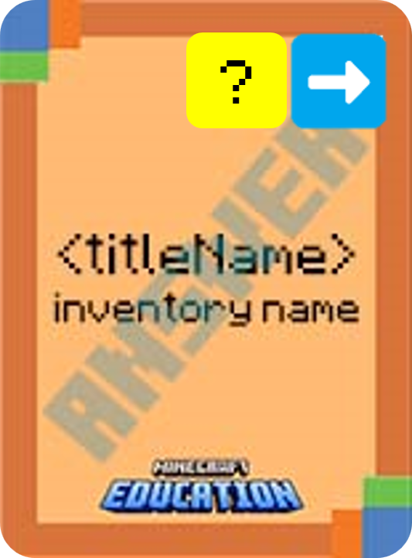
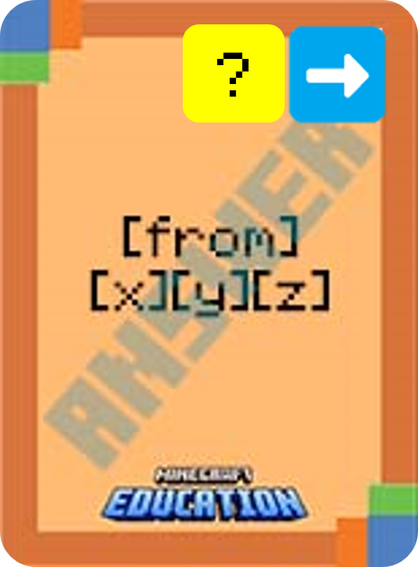
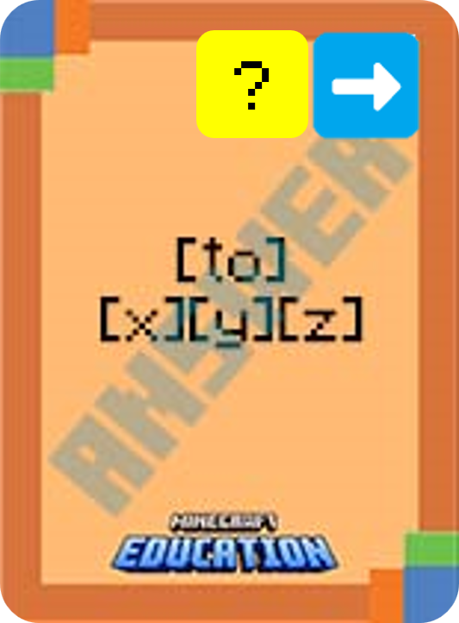
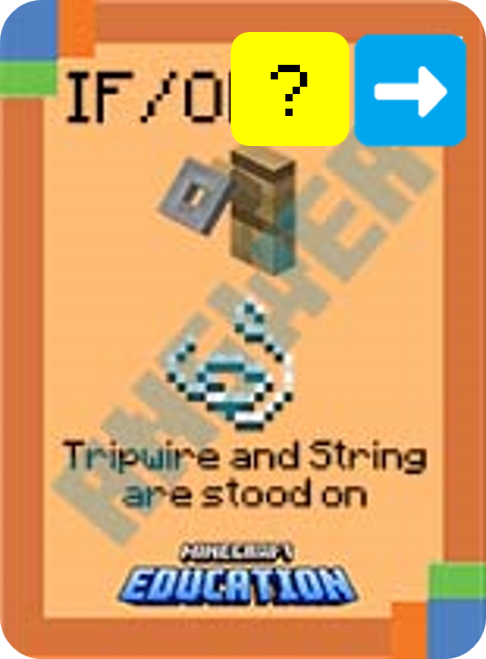
Using your cards, put this algorithm in the correct order:
1
2
3
4
5
Notes:
This is a fun game to play on a timer. Challenge students to use their cards and place the statement in the correct order.

Slide 11
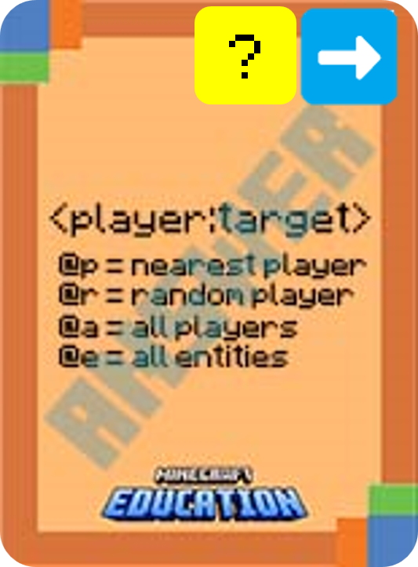
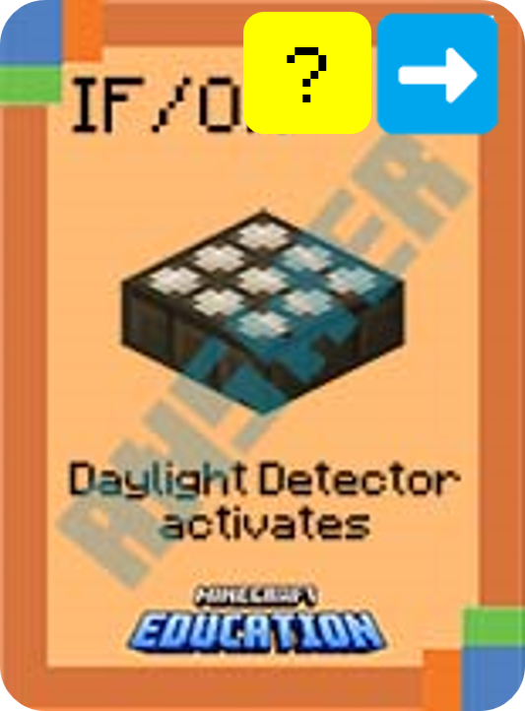
Using your cards, put this algorithm in the correct order:
1
2
3
4
5
Notes:
This is a fun game to play on a timer. Challenge students to use their cards and place the statement in the correct order.

Slide 12
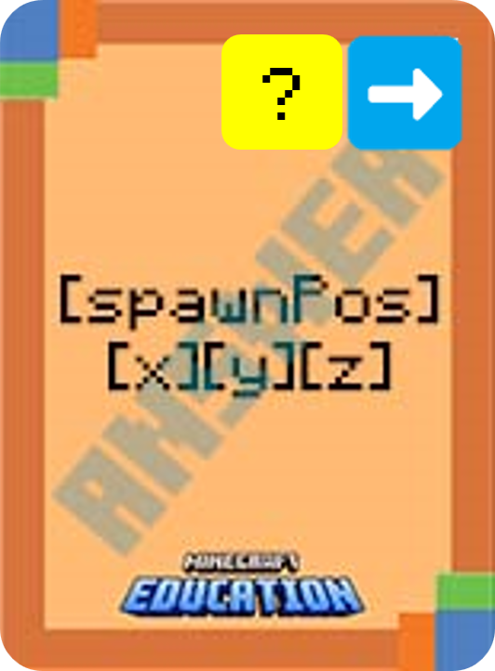
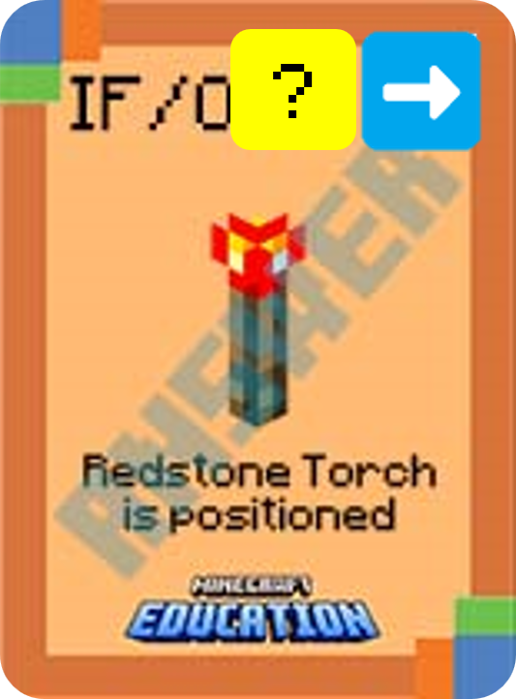
Using your cards, put this algorithm in the correct order:
1
2
3
4
Notes:
This is a fun game to play on a timer. Challenge students to use their cards and place the statement in the correct order.

Slide 13
Intermediate Identifying Errors

Slide 14
What’s wrong with this algorithm?
Identify the problem and use your coding cards to show the correct algorithm.
Notes:
Ask students to identify the error/s in the algorithm by using their cards to display the algorithm correctly.

Slide 15
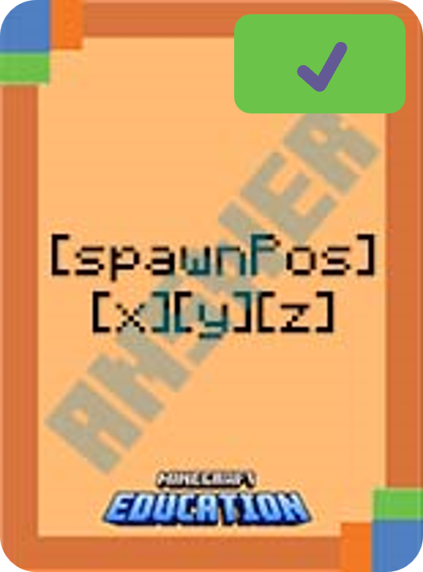
What’s wrong with this algorithm?
Identify the problem and use your coding cards to show the correct algorithm.
Notes:
Ask students to identify the error/s in the algorithm by using their cards to display the algorithm correctly.

Slide 16
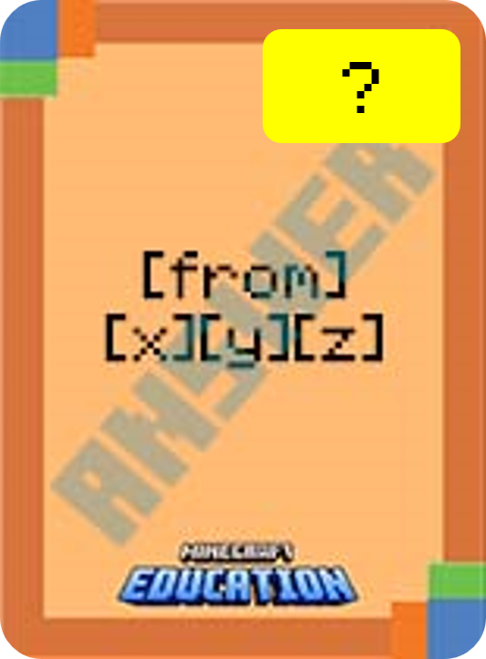
What’s wrong with this algorithm?
Identify the problem and use your coding cards to show the correct algorithm.
✔️
✔️
Notes:
Ask students to identify the error/s in the algorithm by using their cards to display the algorithm correctly.

