Slide 1


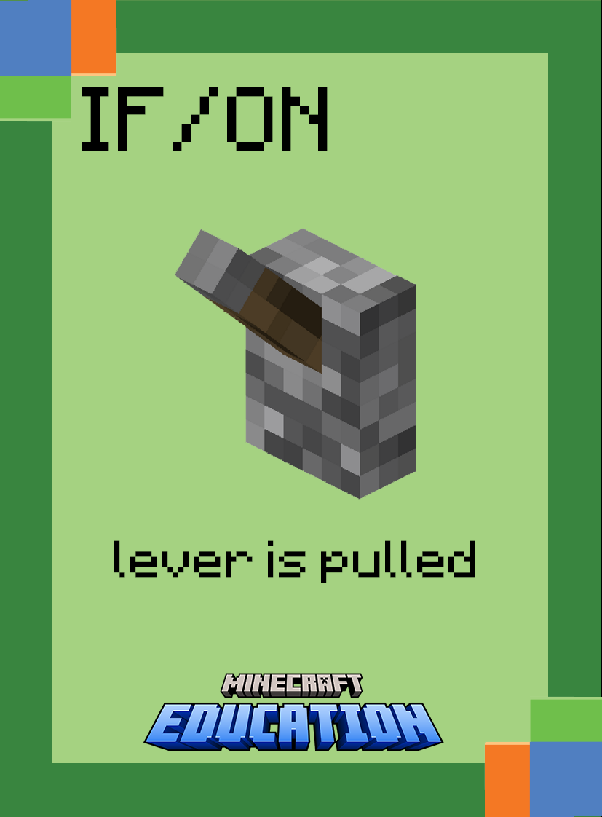
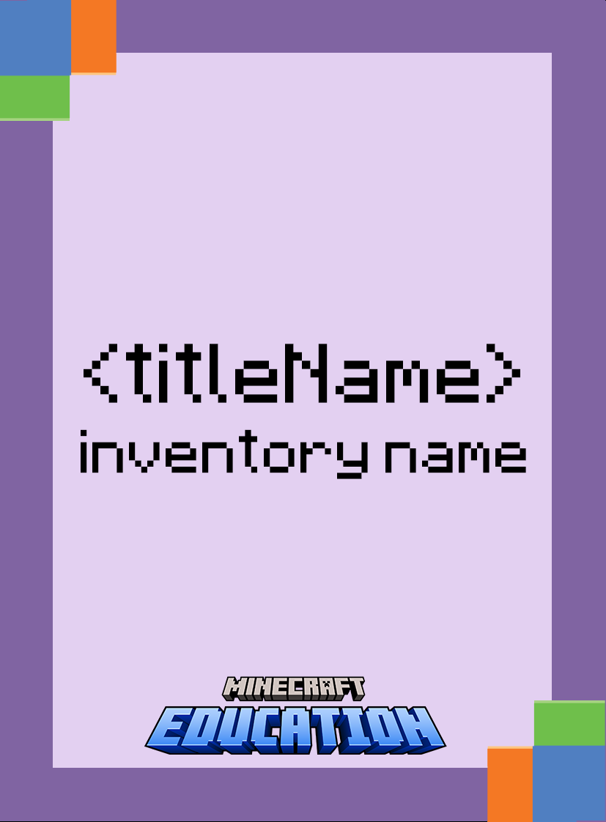

Advanced
Commands

Slide 2
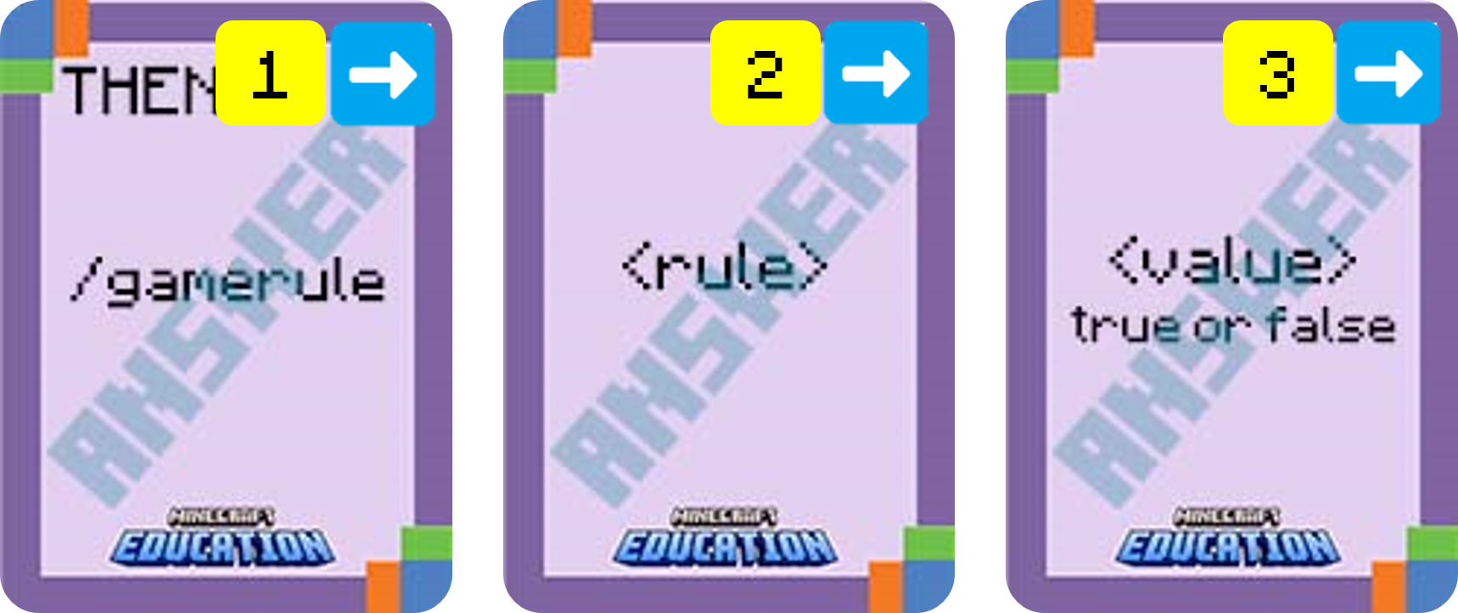

Use your coding cards to show the following command in the correct order.
Game Rule Command
rule is the name of the game rule that you would like to set or view.
value is the value to assign to a rule name (normally true or false).
Notes:
Ask students to display which cards make up the following command. (the answer will be revealed card by card)
Break down the task by asking what each card does. (explanation will appear)
Challenge students to consider a gaming scenario that may use this command

Slide 3
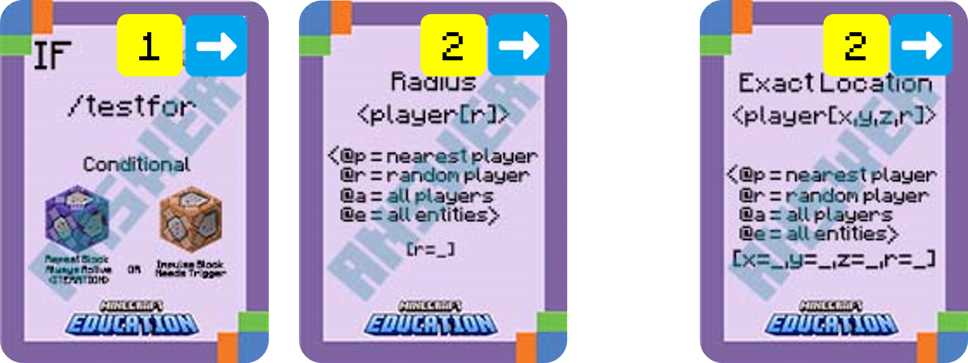
Use your coding cards to show the following command in the correct order.
Testfor Command
or
Player[r=_] is the name of the player (or a target selector) and their radius in blocks from the command block
player[x=_,y=_,z=_r=_] is the name of the player (or a target selector) and the x, y and z coordinated to check for follow by the radius they need to be from that coordinate. To trigger at an exact coordinate r=1
Notes:
Ask students to display which cards make up the following command. (the answer will be revealed card by card)
Break down the task by asking what each card does. (explanation will appear)
Challenge students to consider a gaming scenario that may use this command

Slide 4
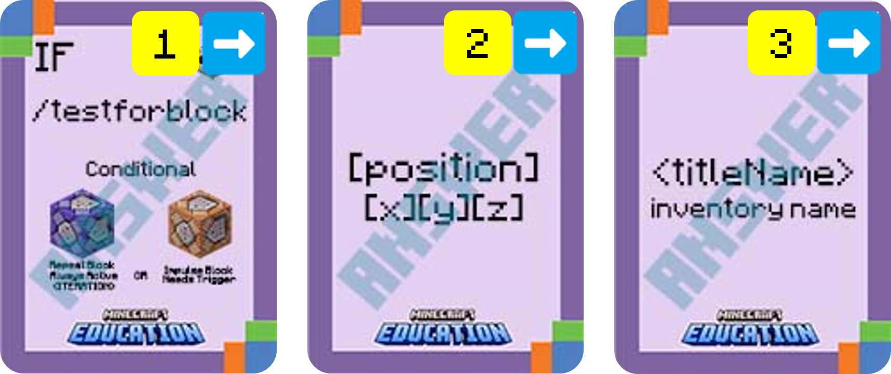
Use your coding cards to show the following command in the correct order.
Testforblock Command
position is the
x y z to test.
titleName is the name of the block to test for.
Notes:
Ask students to display which cards make up the following command. (the answer will be revealed card by card)
Break down the task by asking what each card does. (explanation will appear)
Challenge students to consider a gaming scenario that may use this command

Slide 5
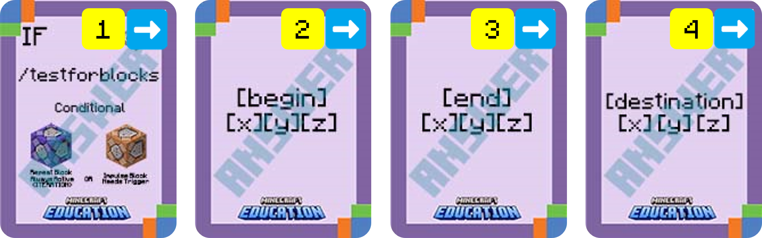
Use your coding cards to show the following command in the correct order.
Testforblocks Command
begin is the starting x y z coordinate for the source region of blocks to compare (ie: first corner block with the smallest coordinate).
end is the ending x y z coordinate for the source region of blocks to compare (ie: opposite corner block).
destination is the x y z coordinate for the destination region of blocks. Use the lowest x,y,z values for the destination. This will be the bottom NorthWest corner of the destination region.
Notes:
Ask students to display which cards make up the following command. (the answer will be revealed card by card)
Break down the task by asking what each card does. (explanation will appear)
Challenge students to consider a gaming scenario that may use this command

Slide 6
Advanced
Unpacking Algorithms

Slide 7


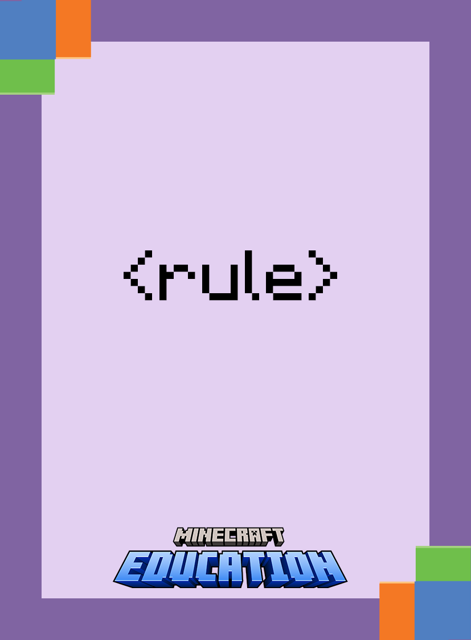

Place your cards in the correct based on the following algorithm.
IF a disc is placed in a Jukebox, THEN set the gamerule allow mobs to true

Slide 8
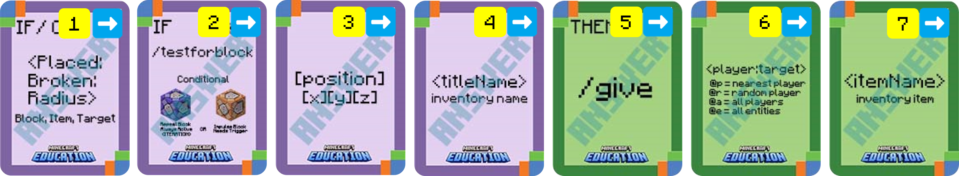
Place your cards in the correct based on the following algorithm.
ON a block is placed IF at world position 594 12 45 a block of gold is detected, THEN give the nearest player a lever

Slide 9
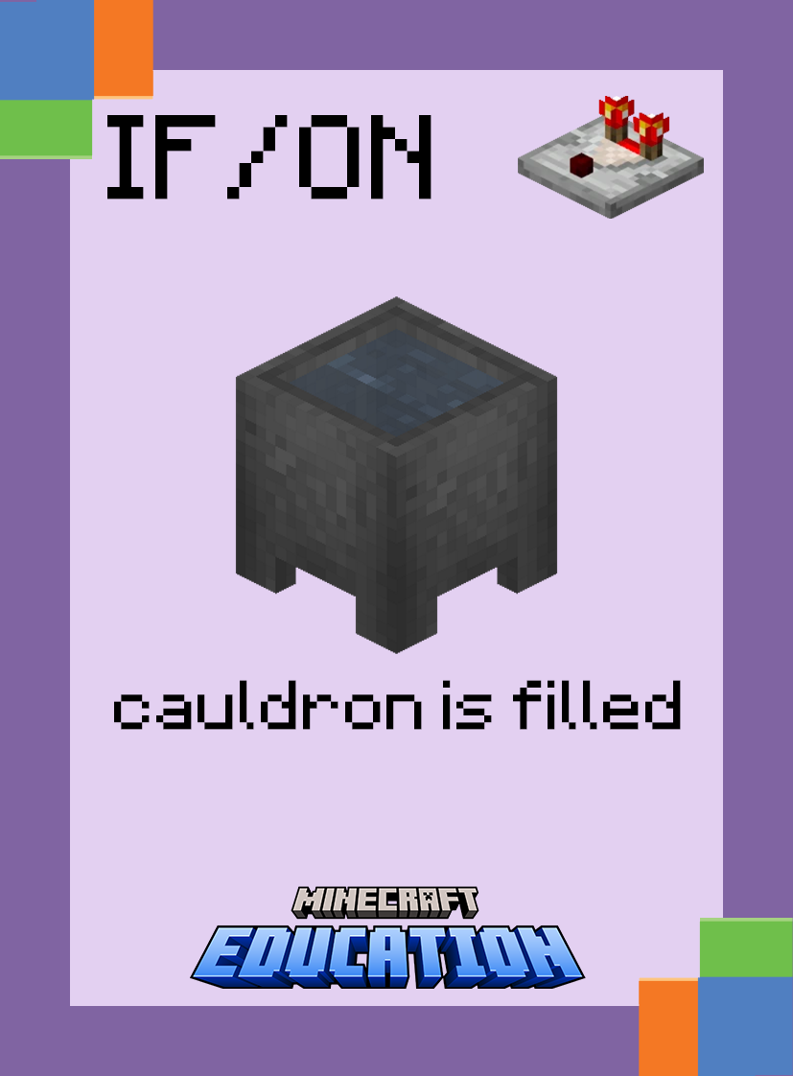
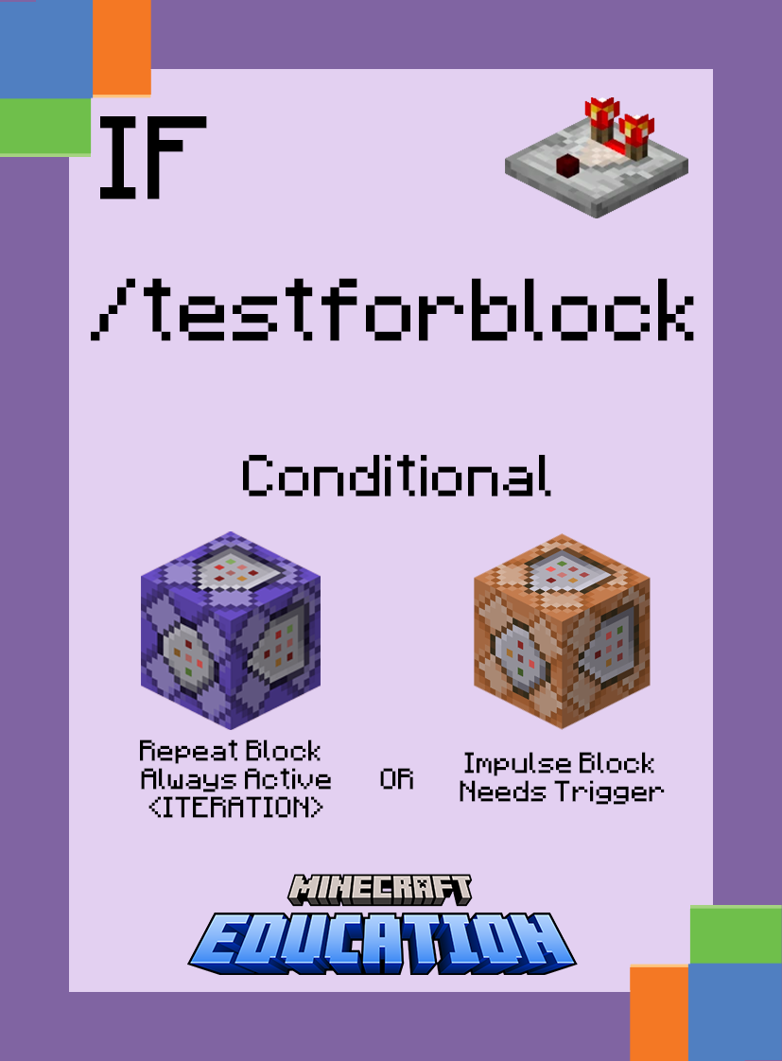
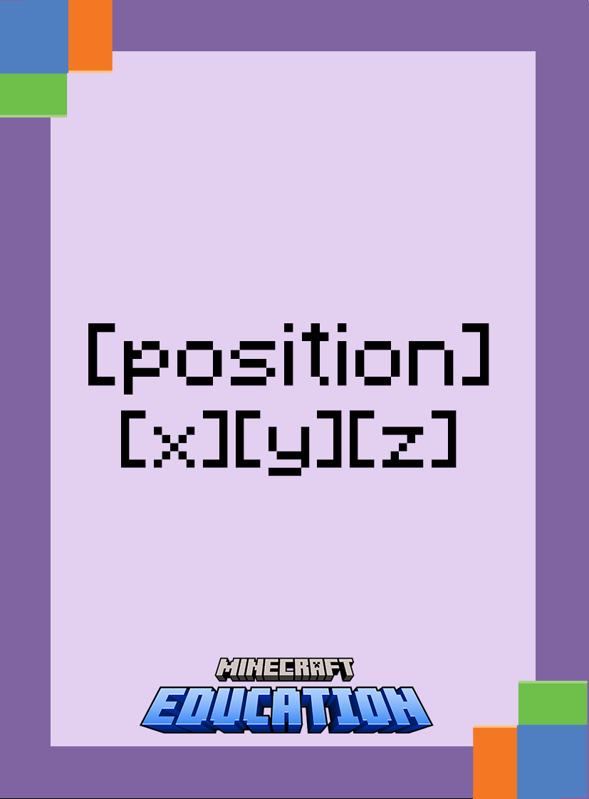

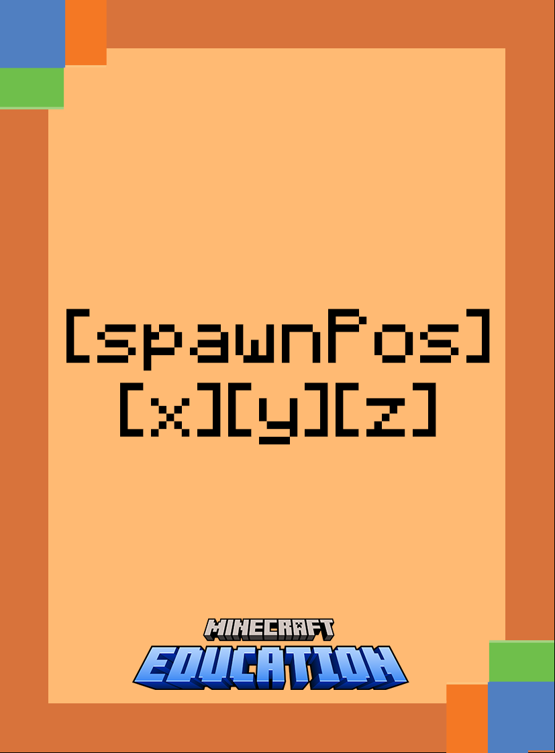
Place your cards in the correct based on the following algorithm.
ON a cauldron is filled, IF a block of gold is at world position 325 11 23, THEN summon a zombie to 325 11 25

Slide 10
Advanced
Sorting Algorithms

Slide 11
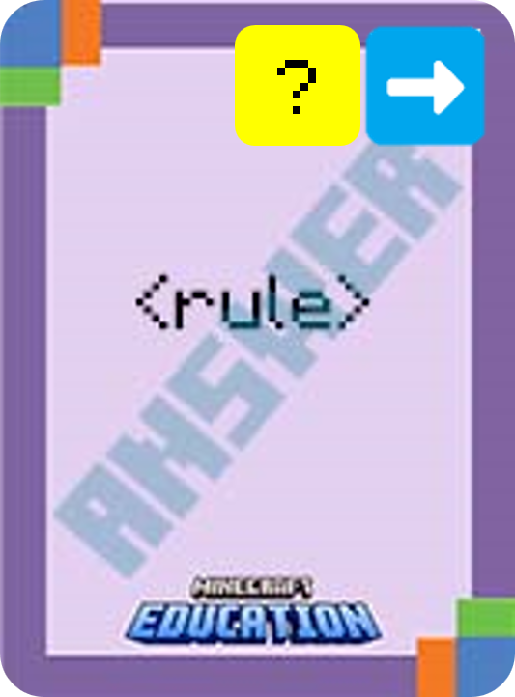
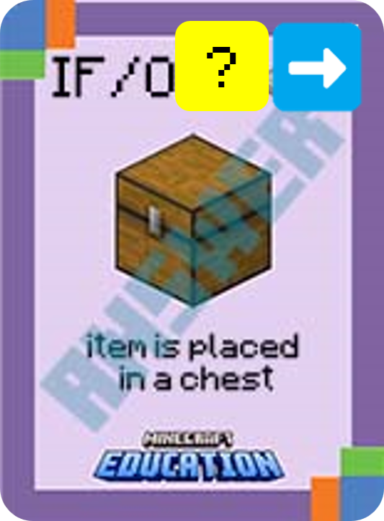
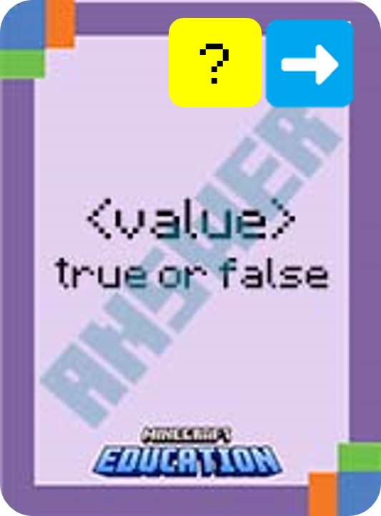


Using your cards, put this algorithm in the correct order:
1
2
3
4
Notes:
This is a fun game to play on a timer. Challenge students to use their cards and place the statement in the correct order.

Slide 12
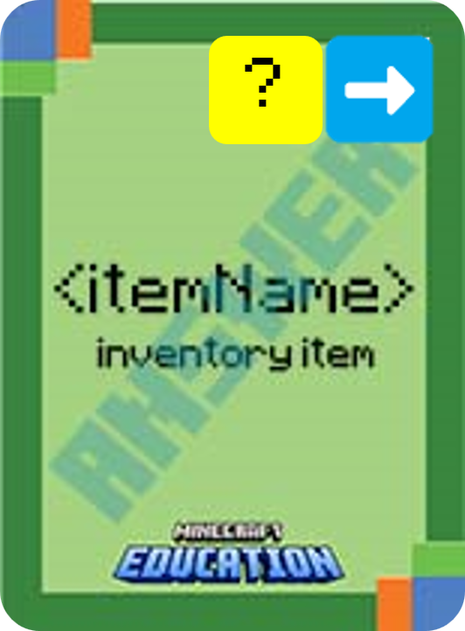
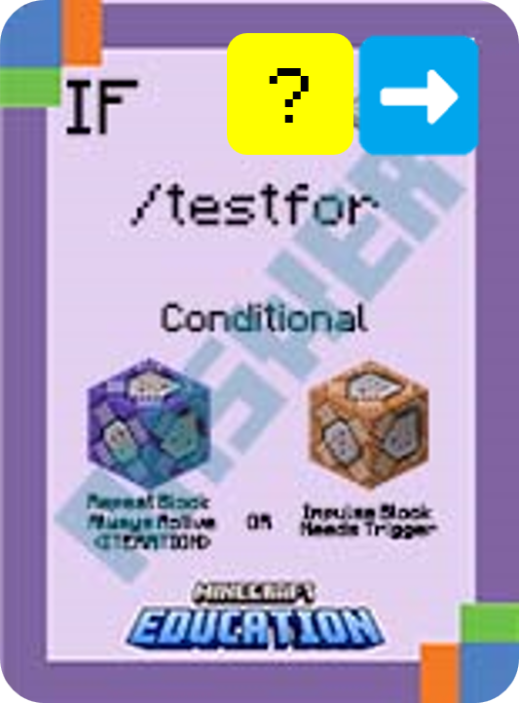
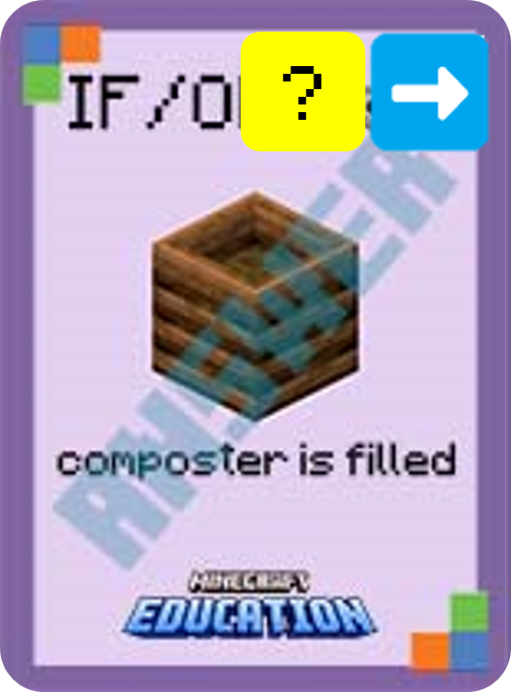
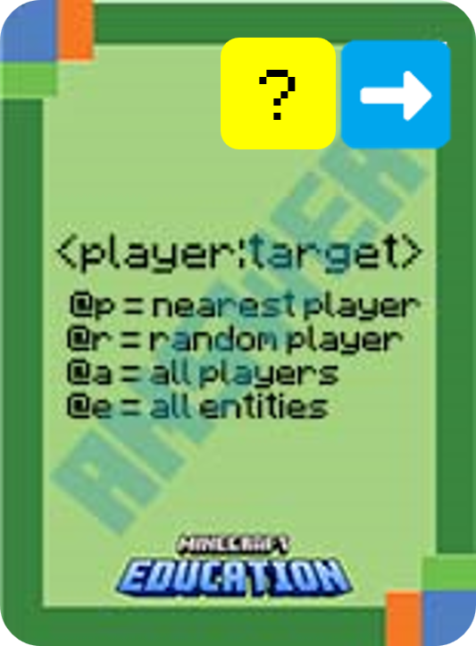
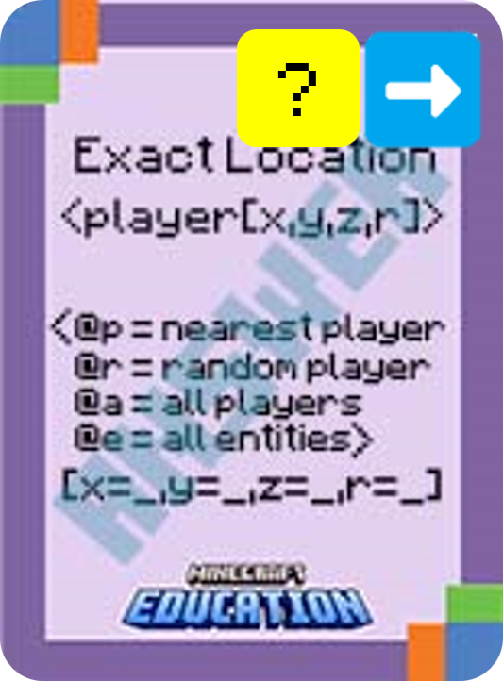

Using your cards, put this algorithm in the correct order:
1
2
3
4
5
6
Notes:
This is a fun game to play on a timer. Challenge students to use their cards and place the statement in the correct order.

Slide 13
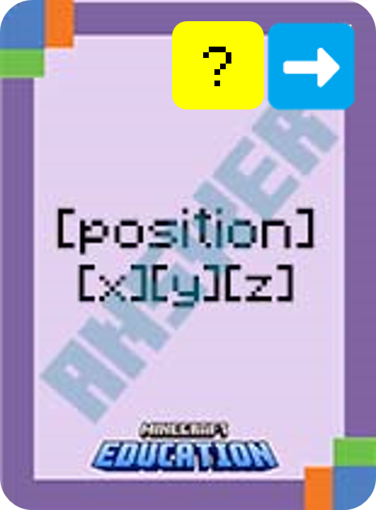

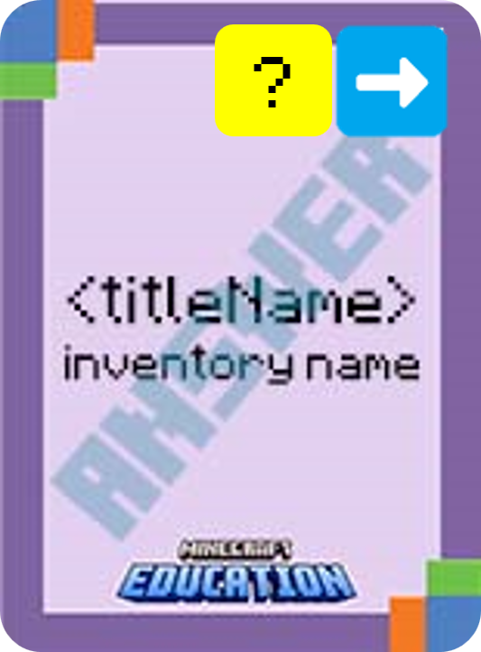
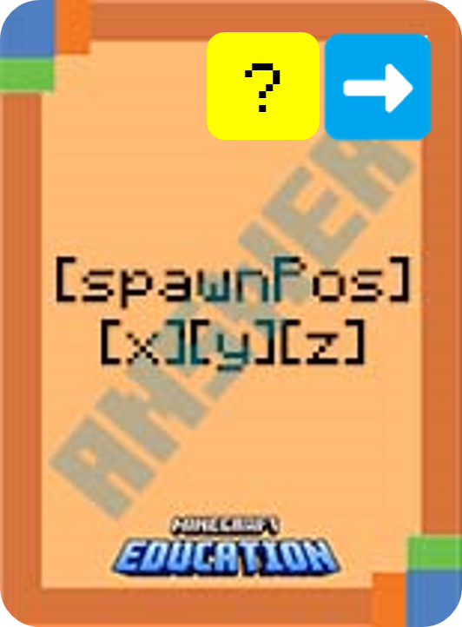
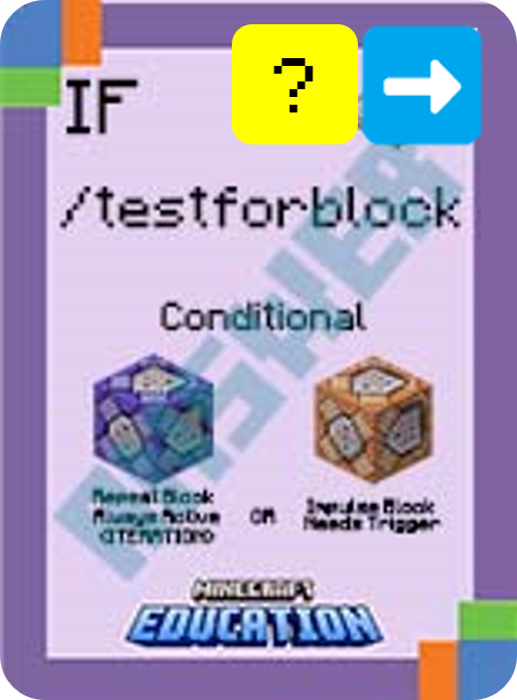

Using your cards, put this algorithm in the correct order:
1
2
3
4
5
6
Notes:
This is a fun game to play on a timer. Challenge students to use their cards and place the statement in the correct order.

Slide 14

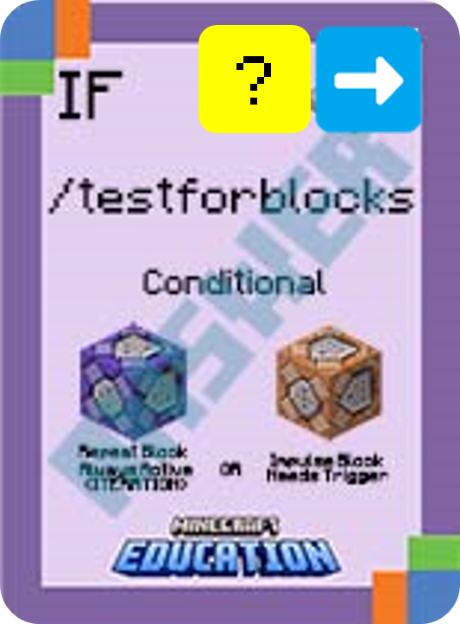
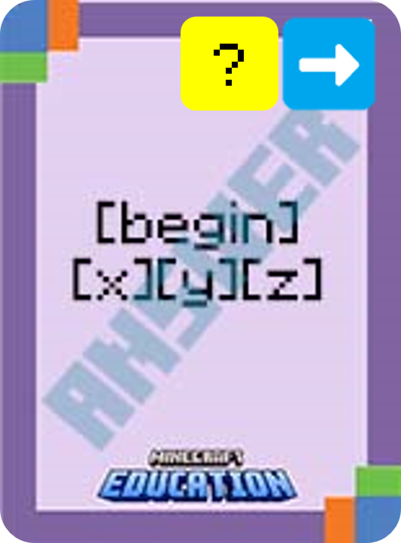
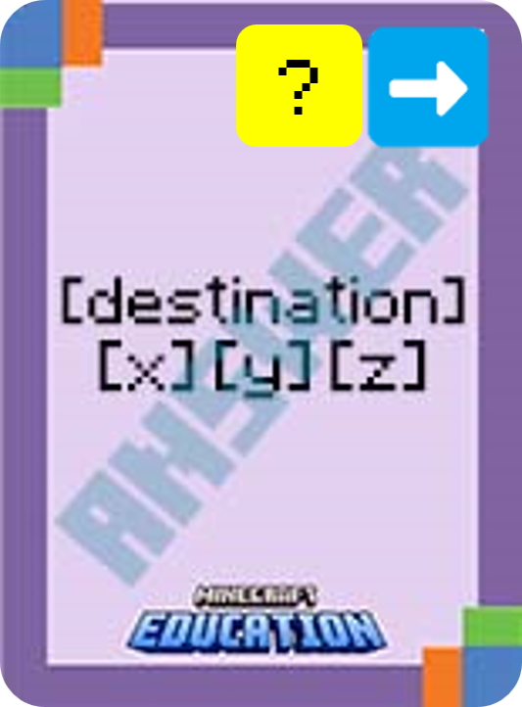
Using your cards, put this algorithm in the correct order:
1
2
3
4
5
6
7
Notes:
This is a fun game to play on a timer. Challenge students to use their cards and place the statement in the correct order.

Slide 15
Advanced
Identifying Errors

Slide 16
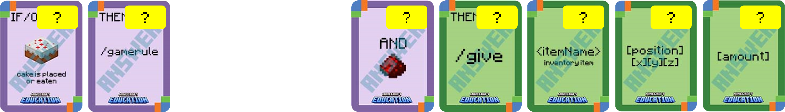
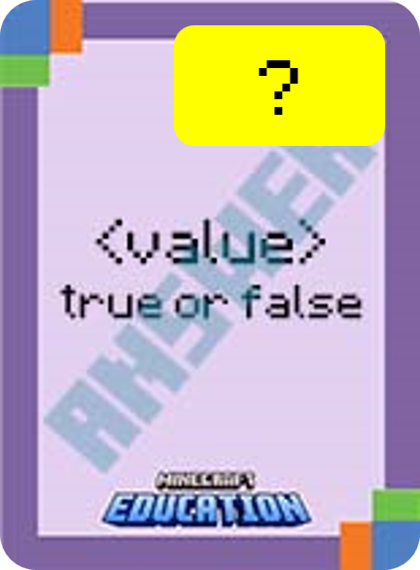

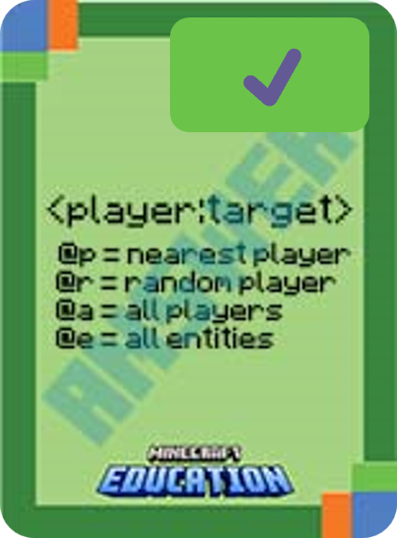
What’s wrong with this algorithm?
Identify the problem and use your coding cards to show the correct algorithm.
✔️
✔️
Notes:
Ask students to identify the error/s in the algorithm by using their cards to display the algorithm correctly.

Slide 17
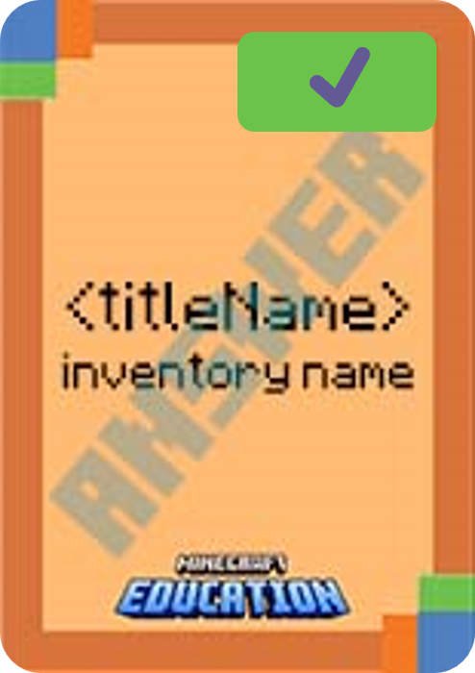
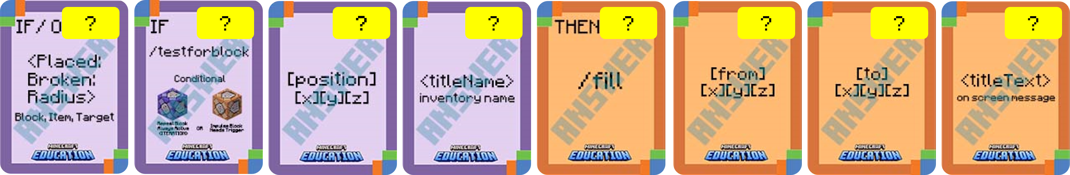
What’s wrong with this algorithm?
Identify the problem and use your coding cards to show the correct algorithm.
Notes:
Ask students to identify the error/s in the algorithm by using their cards to display the algorithm correctly.

Slide 18
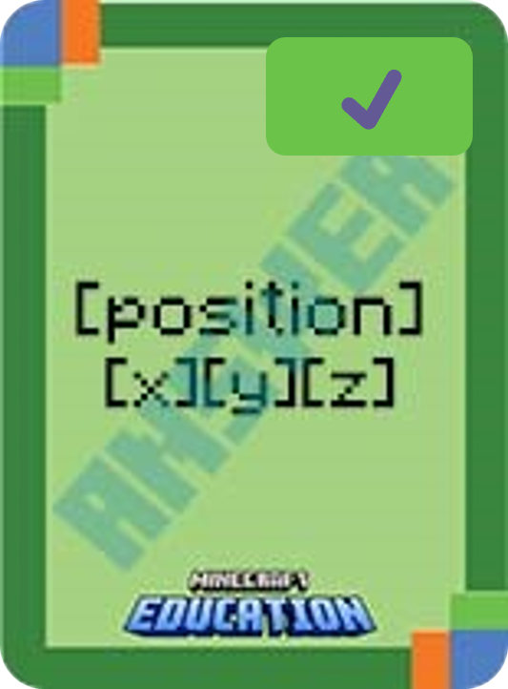
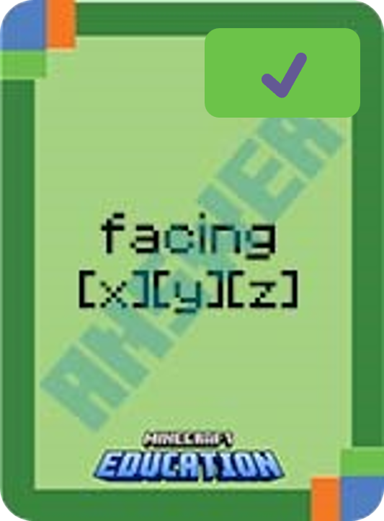
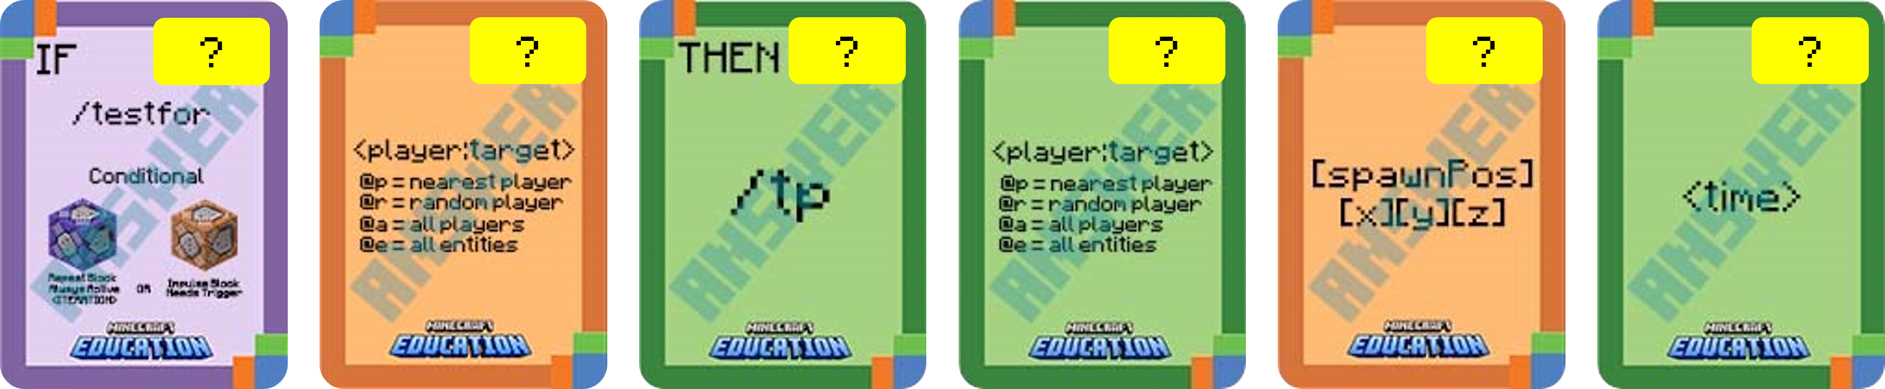
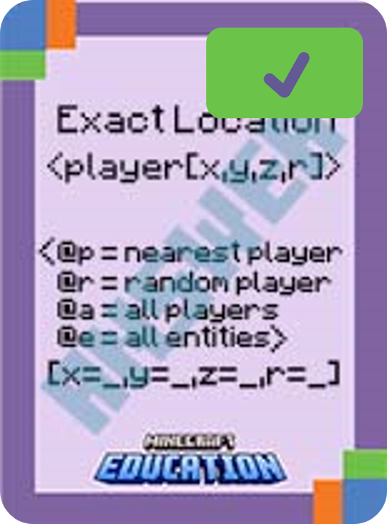
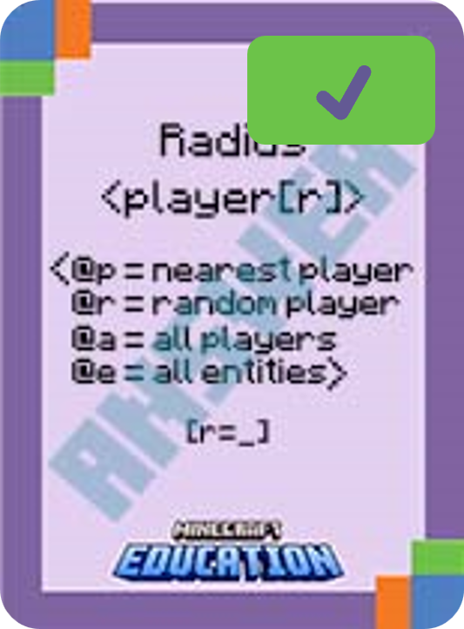
What’s wrong with this algorithm?
Identify the problem and use your coding cards to show the correct algorithm.
OR
Notes:
Ask students to identify the error/s in the algorithm by using their cards to display the algorithm correctly.

Slide 19


Slide 20


Slide 21


Slide 22


