Slide 1



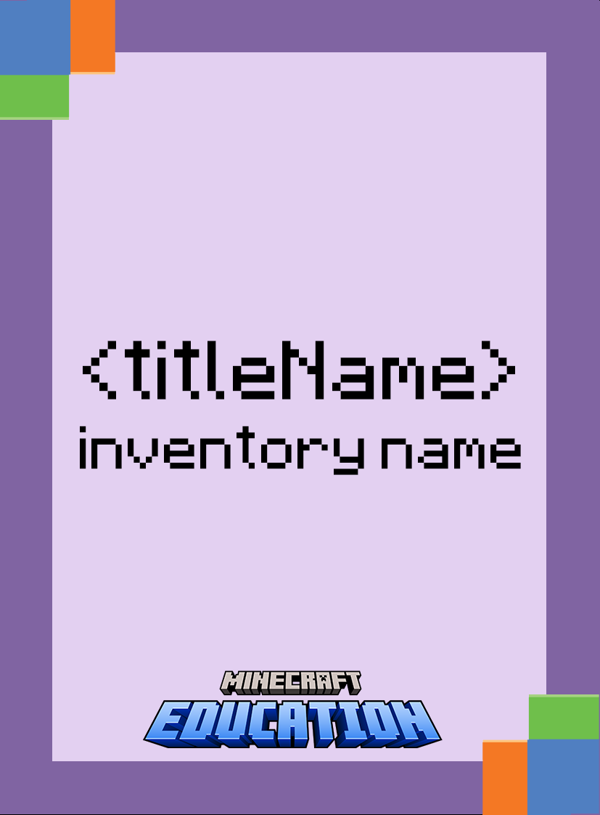

Sample Activities
Suggestions and guidelines can be found in the notes of each slide.
Learn more: bit.ly/digitalrichards

Slide 2

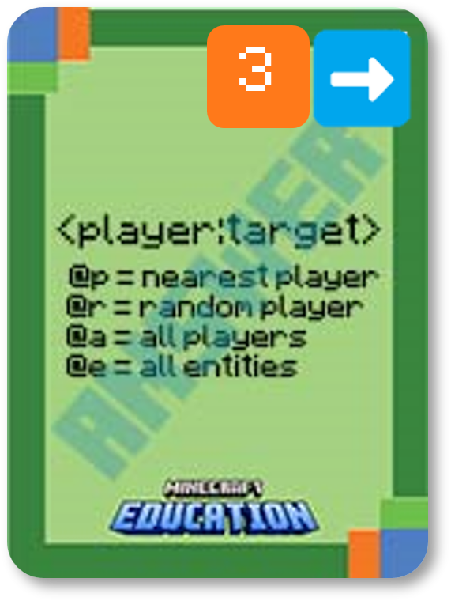
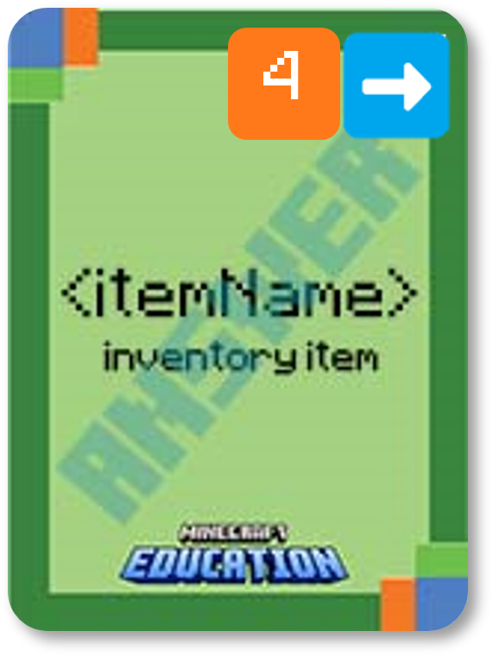
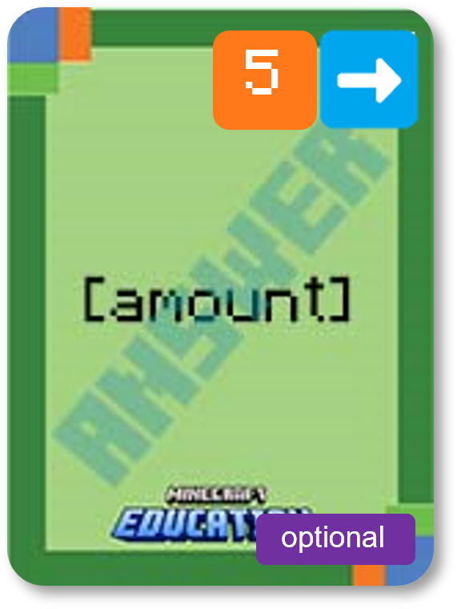
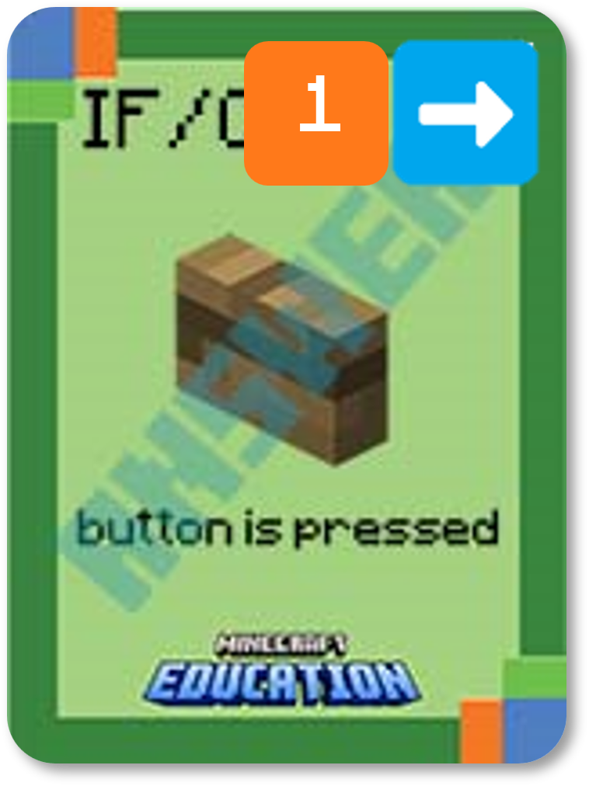
IF and THEN Statements
SAMPLE
IF
THEN
Create a statement with a different IF card and explain how it would apply to a gaming scenario.
Decide who will be given the item, what they will get and the amount. Then explain how that could apply to gameplay.
Notes:
First, reveal the statement. You may like to only reveal the first card of the THEN statement and see if your students can determine the remaining cards.
Secondly, challenge your students to think of different IF cards and how this statement would apply in gameplay. They could share with the class and write their explanation in their book or OneNote.

Slide 3
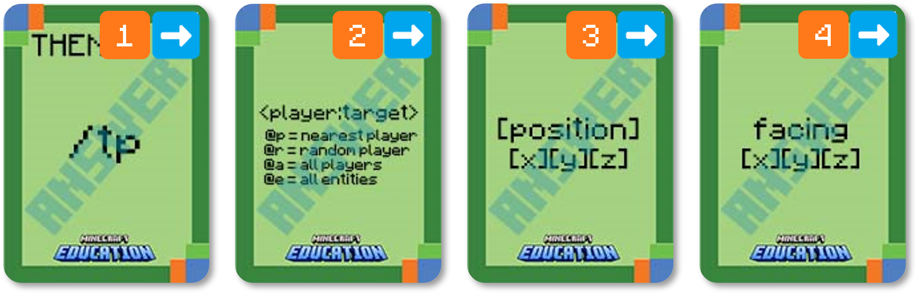
Use your coding cards to show the following command in the correct order.
SAMPLE
Teleport Command
optional
player is the name of the player (or a target selector) to teleport.
x y z is the coordinate to teleport to.
facing is optional and is a set of x y z coordinates that the player will face after being teleported.
Notes:
Ask students to display which cards make up the following command. (the answer will be revealed card by card)
Break down the task by asking what each card does. (explanation will appear)
Challenge students to consider a gaming scenario that may use this command

Slide 4
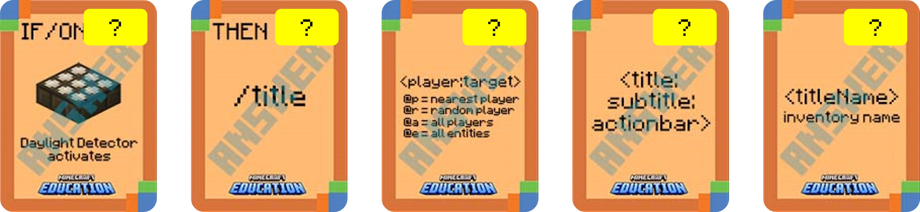

SAMPLE
What’s wrong with this algorithm?
Identify the problem and use your coding cards to show the correct algorithm.
Notes:
Ask students to identify the error/s in the algorithm by using their cards to display the algorithm correctly.

Slide 5
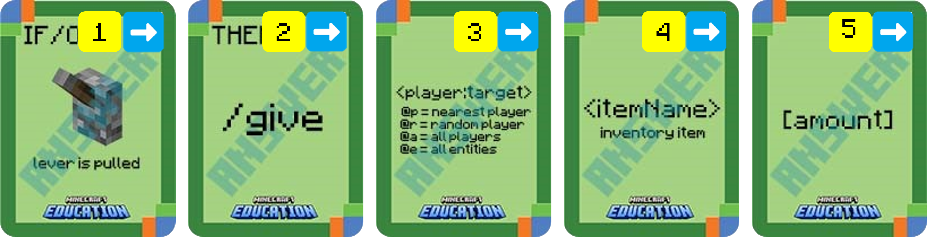
Place your cards in the correct order based on the following algorithm.
SAMPLE
IF a lever is pulled, THEN give the nearest player an apple times 10.

Slide 6
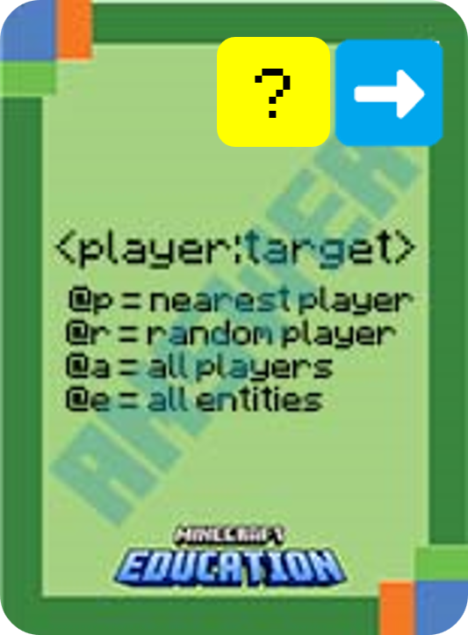

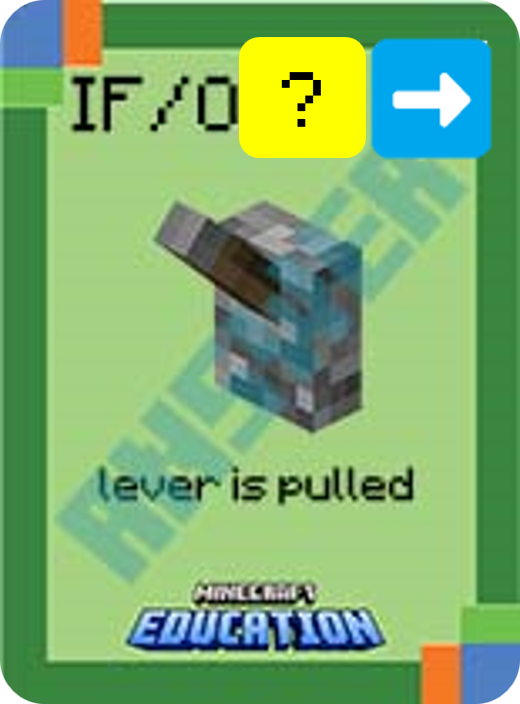

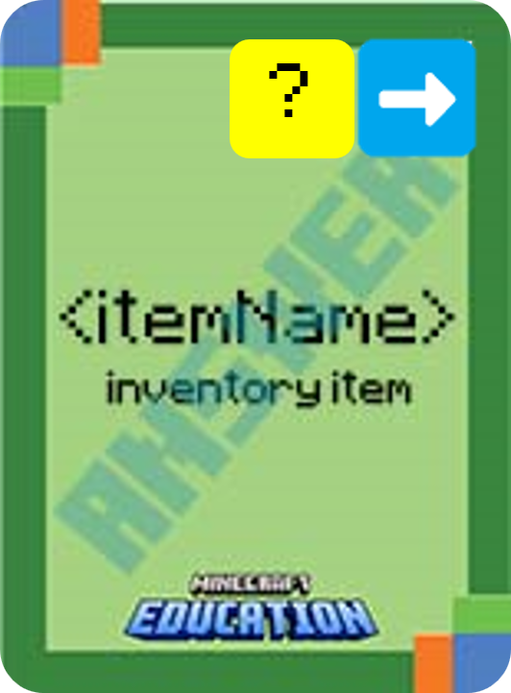
Using your cards, put this algorithm in the correct order:
SAMPLE
Notes:
This is a fun game to play on a timer. Challenge students to use their cards and place the statement in the correct order.

